Slide 1


Films
Spotlight 9 Module 5 d
работа выполнена учителем английского языка МОБУ Никитинская СОШ Саракташского района Оренбургской области
Тукманбетовой Л.Р.

Slide 2
Films
verbs
people
types
act
star in
produce
shoot
review
actress
director
producer
camera operator
scriptwriter
make-up artist
costume designer
western
comedy
thriller
horror
musical
adventure
animated

Slide 3
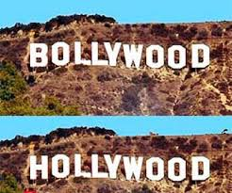
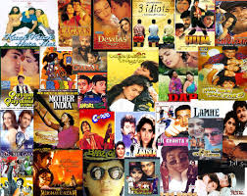
H
B
ollywood

Slide 4
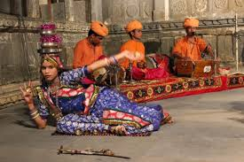
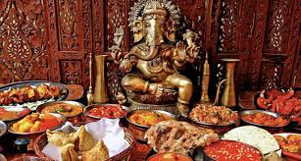
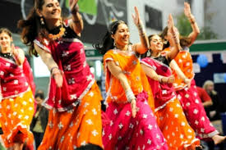
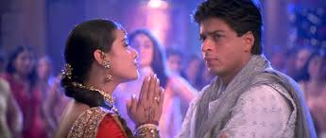
1899
colourful costumes
kidnappers
dancing
tears
romance
songs
for girls
Hollywood
Britain
national food
sad
traditions

Slide 5
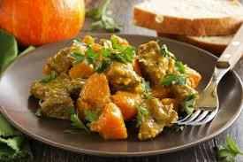
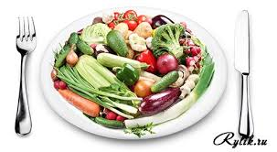
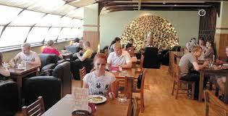
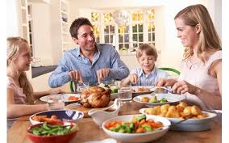
Would prefer/Would rather
I prefer vegetables to meat.
General preference
I would prefer to go to a restaurant ( rather) than eat in.
Specific preference

Slide 6
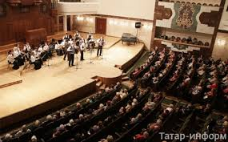
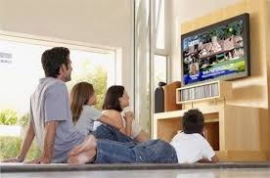
I would rather/sooner go to the concert than stay at home.
1. going to the theatre or going to the cinema
2. getting a takeaway or eating out at a restaurant
3. watching action films or watching comedies
4. going to the cinema or watching TV all day today

Slide 7
Do you like … films?
Not really. I prefer … to … .
How about … tonight?
I’d rather watch … than … watch … .

Slide 8
http://cdn.bolshoyvopros.ru/files/users/images/73/42/7342fa333daf4196b333a3fc0f218441.jpg
http://phototour.pro/kcfinder/upload/images/bollywood_9.jpg
http://i57.fastpic.ru/big/2014/0209/47/16305621007ca5ea2c171fe257c77e47.jpg
http://rylik.ru/uploads/posts/2013-12/1387785294_shutterstock_1093828551.jpg https://encrypted-tbn1.gstatic.com/images?q=tbn:ANd9GcQTqW5tE41dLkk9IVO994bx4yK-1qFXoYW9SZhkcRg6YRtgz0qWwA
http://volbusiness.ru/assets/images/magazines/shtof.jpg
https://cloudstatic.eva.ru/eva/60000-70000/67844/channel/semej_nye_uzhiny_10767255073696256.jpg?H
http://i1.tatar-inform.ru/image/2014/10/01/koncert.jpg
http://www.wmeste.by/wp-content/uploads/2012/04/watching-tv-300x198.jpg

